Slide 1
Chapter 1 The Essentials for College Success

Slide 2

Assess Your Strengths and Set Goals
College is an important investment of time, money, and effort, and for some students the college experience can be transformative.
Do you already have a good understanding of how to thrive in college and why it is so important? What personal and career goals do you want to pursue during and after college?

Slide 3
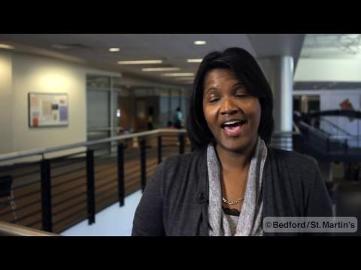
http://drive.google.com/file/d/1zhm79Ev3CQK9s9mjRPBni93yFAm9aSmf/view
Notes:
Possible discussion starter questions:
What foundation do you need for the goals you’ve set for yourself? How will you build this foundation?
Why is it essential to have a support network when you are working to reach your goals? What are the characteristics of those individuals you would want in your support network?
How will accomplishing short-term goals motivate you to accomplish you long-term goals?

Slide 4
Thriving in College and Life
It is important that you are not only “successful” in college and life, but that you thrive in both. Thriving means:
Going beyond minimum requirements to meet and exceed goals
Discovering talents and abilities
Deriving self-satisfaction, self-esteem, and pleasure
Notes:
Instructors: Ask your students about the expectations they had before they came to college.

Slide 5
Making the Most of the College Success Course
College success courses introduce students to a central topic: how to be a successful students in college and successful in life.
Research in the field of “student success” has found that college success courses:
Increase the likelihood of success in college
Increase student involvement in student organizations, campus activities, and interactions with faculty
Prepare students to make better choices while they are in college
Notes:
Instructors: Another takeaway to note is that college success courses provide a supportive environment for students.

Slide 6

The VIPS of Your College Experience
The people you meet in colleges and universities will have a great influence on your experiences.
There are all kinds of people in college. Some of the people you meet will be students, instructors, administrators, advisers, and other staff members.

Slide 7
Students
Of all the different types of people on campus, the ones who will likely have the most influence on you and your choices are your fellow students. There are many different types of students:
Traditional and non-traditional
Veterans
International
Part-time
Peer leaders
What type of student are you?
Notes:
Instructors: Have the class identify what type of student they are to generate class discussion and introductions. Review the challenges and opportunities associated with each type of student.

Slide 8
Instructors
Instructors have the greatest influence on students because they influence your thinking and understanding. Instructors will:
Not tell you what, how, or when to study
Rarely monitor your progress
Usually have private offices and keep regular office hours when they can meet with you

Slide 9
Academic Advisors
Academic advisors can help you map out your course of study and stay on track to graduation. When working with an academic advisor:
Use course catalog and consider majors
List majors that appeal to you
Know what prerequisites and co-requisites you will need to take for your major
Know what to take away from the meeting

Slide 10
Staff Members/Administrators/Advisers
These individuals provide all kinds of assistance and support:
Make significant policy decisions
Determine important financial allocations and priorities
Help govern the institution

Slide 11

The Value of College
The value of college can be measured in many different ways:
Enables social mobility and being evaluated on the basis of merit
Improves earning potential
Increases the likelihood of employment
Why is college important to you?
Notes:
Instructors: Other benefits of college discussed in the text are that it prepares students for certain roles in society and provides professional networks.

Slide 12
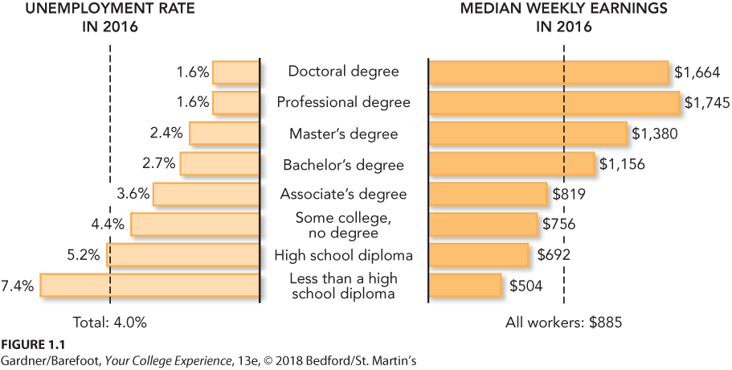
“Education Pays”
Notes:
Instructors: Ask your students which is more important: education for its own sake or education for the sake of earning more money?

Slide 13
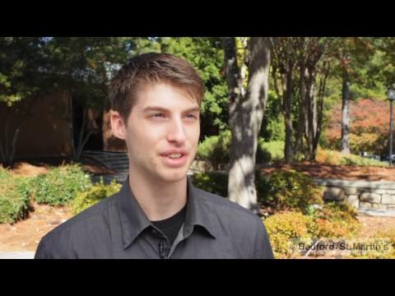
http://drive.google.com/file/d/147AeM4xYHrD-WZUDL6Kg8OoApwZUGOCe/view
Notes:
Possible class discussion questions:
Why are you in college? Have you thought critically about yourself and what you want to accomplish while you are in school?
Have you set goals for yourself based on your purpose for attending college? How does your purpose influence your goals?
How might knowing your interests and values help you make appropriate academic choices?

Slide 14
Exploring Purpose and Setting Goals
Your purpose for coming to college may change as you discover more about yourself. Purpose connects to motivation and plays out in the choices college students make.
Understanding your purpose will help you to set the right goals.
What is your motivation for attending college?

Slide 15
Goal Setting (1 of 2)
How do you define success? Where do you start in the quest for success?
Success will be the result of intentional steps you take and your accomplishments. To get started:
Identify your personal strengths.
Ask yourself tough questions.
Establish goals for today, this week, this year, and beyond.

Slide 16
SMART Goals
Consider how your goals fall within the framework of SMART goals:
Specific
Measureable
Attainable
Relevant
Time frame achievability
Be realistic and honest with yourself about your goals.

Slide 17
Making Choices
You will make choices every day of your college career, and they can either support or sabotage the achievement of your larger goals and purposes in college and beyond.
It is important to understand the concept of locus of control:
Exercising maximum control over your own life by freely making choices
An active view rather than a passive view of self

Slide 18

Guided Pathways
Guided pathways are a proscribed set of courses leading to certain majors and degrees.
Based on information about whether students will be more or less likely to complete courses successfully
Pathways may help you save time, money, and energy by choosing courses that are right for you

Slide 19
Tech Tip: E-Mail with Style
At some point you will need to communicate with your instructor via e-mail. Some tips to remember:
Use your college e-mail address.
Make the subject line informative.
Address your instructor with respect.
Notes:
Instructors: Other tips to share with students are that they should 1) Sign every e-mail with full name, course number, and e-mail address; and 2) Use widely accepted file formats such as .doc or .pdf when attaching files.

Slide 20
Reflection
Reflect on your decision to enter this college at this time of your life. Who influenced your decision?
College students often feel the stress of trying to balance their personal and academic lives. How can you include time to engage in at least one high-impact practice each year?

